Slide 1
CLOUD COMPUTING
23CS009
Bachelor of Engineering- Computer Science & Engineering
Week 4
Content: Cloud. Cloud Service Models- Introduction to Cloud Service Models, Infrastructure as a Service (IaaS) Layer, Platform as a Service (PaaS) Layer, Software as a Service (SaaS),Difference Between IaaS, PaaS, and SaaS, Cloud data lifecycle phases.
Department of Computer Science & Engineering
Chitkara University Institute of Engineering and Technology, Chitkara University, Punjab, India

Slide 2
CLOUD COMPUTING SERVICES
Cloud service models are the different ways that cloud computing services are offered to customers.
Cloud services provide resources, tools, and services to businesses over the internet, eliminating the need for complex on-premises infrastructure.
Each type of cloud computing provides different levels of control, flexibility, and management so that you can select the right set of services for your needs.
Cloud service models include:
Infrastructure as a Service (IaaS)
Platform as a Service (PaaS),
Software as a Service (SaaS)

Slide 3
CLOUD COMPUTING SERVICES: IaaS
Infrastructure as a Service (IaaS)
IaaS provides businesses with essential IT infrastructure, including virtual machines, storage, and networking.
The cloud provider offers hardware and virtualization, along with an operating system.
Users decide the type of operating system (e.g., Ubuntu, Fedora) and are responsible for managing applications on top of it.
It provides the highest level of flexibility and control over IT resources.
Example: Amazon EC2

Slide 4
CLOUD COMPUTING SERVICES: PaaS
Platform as a Service (PaaS)
PaaS removes the need for you to manage underlying infrastructure (usually hardware and operating systems), and allows you to focus on the deployment and management of your applications.
Here, the provider manages the OS, middleware, and runtime.
It provides a runtime environment. It allows programmers to easily create, test, run, and deploy web applications.
Example: Amazon RDS

Slide 5
CLOUD COMPUTING SERVICES: SaaS
Software as a Service (SaaS)
SaaS delivers fully functional software applications over the internet. These applications are managed entirely by the service provider.
No setup or maintenance is required on the user’s end.
The service provider handles infrastructure, application maintenance, and updates.
In most cases, people referring to SaaS are referring to end-user applications.
Here, the focus is on how to use the software, not on how it works behind the scenes.
Example: Gmail

Slide 6
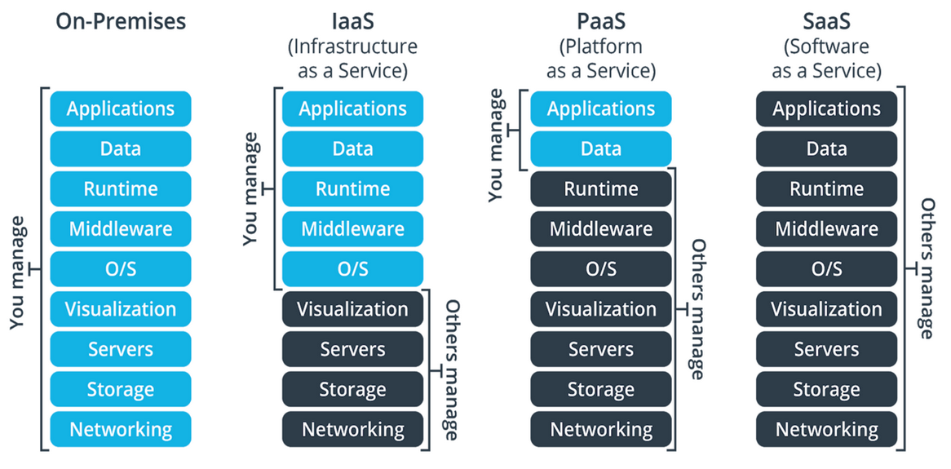
CLOUD COMPUTING SERVICES
Figure: Cloud Computing Services

Slide 7
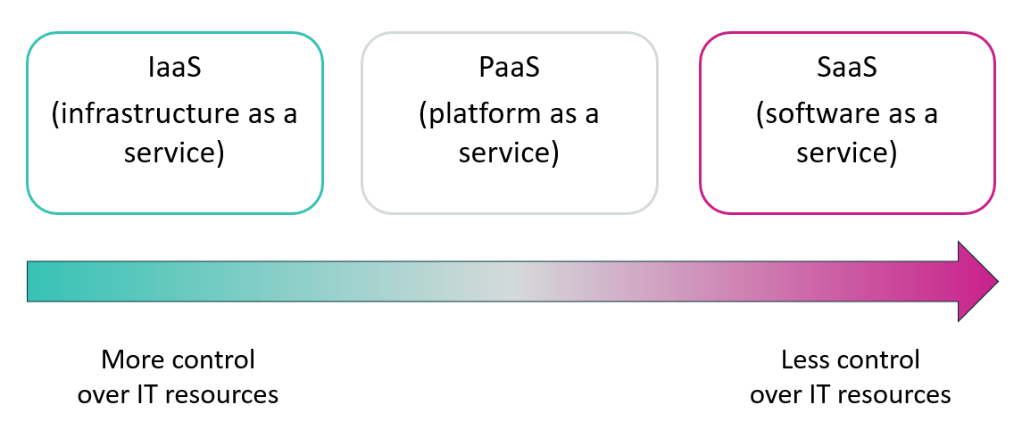
CLOUD COMPUTING SERVICES
Figure: Cloud Computing Services Control

Slide 8
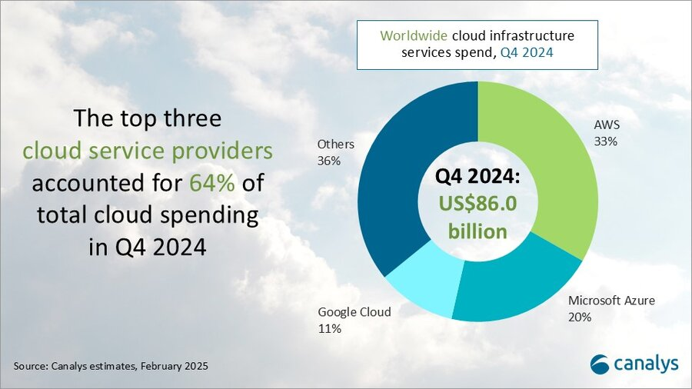
Worldwide cloud infrastructure services spend
Figure: Worldwide cloud infrastructure services spend

Slide 9
Worldwide cloud infrastructure services spend Cont’d
Total global cloud spending reached US$86.0 billion in Q4 2024.
The top three cloud service providers : Amazon Web Services (AWS), Microsoft Azure, and Google Cloud; collectively accounted for 64% of this total spending.
AWS led the market with a 33% share, maintaining its dominant position.
Microsoft Azure followed with a 20% share, reinforcing its role as a strong competitor.
Google Cloud held an 11% share, continuing its growth as a major cloud player.
Other providers together made up the remaining 36% of the market.
This distribution reflects ongoing trends in cloud adoption, digital transformation initiatives, and the growing demand for scalable, on-demand infrastructure services across industries.

Slide 10
Cloud Data Lifecycle Phases
The cloud data lifecycle refers to the stages data undergoes from its creation or collection in a cloud environment to its deletion.
Understanding these phases ensures proper data management, security, and compliance in cloud computing. The lifecycle generally comprises the following phases:
Data Creation/Generation – Data is created or generated.
Data Storage – Data is securely stored in the cloud.
Example: Data is stored in cloud storage services like Amazon S3, Google Cloud Storage, or Microsoft Azure Blob Storage.
Data Processing – Data is processed and analyzed. Example: Analyzing customer behavior data by running machine learning algorithms on data in the cloud.
Data Access and Usage – Data is accessed and used by authorized users or applications.

Slide 11
Cloud Data Lifecycle Phases Cont’d
Data Sharing and Collaboration – Data is shared for collaborative work.
Example: Sharing a document in Google Drive or collaborating on a dataset in a cloud-based analytics platform like AWS Redshift or Google BigQuery.
Data Archival – Data is archived for long-term storage.
Example: Moving old files or logs to Amazon Glacier
Data Backup – Data is backed up for disaster recovery.
Example: Automatically backing up critical business data to a cloud service such as AWS Backup or Azure Backup.
Data Security and Privacy Management – Data is protected through security measures.
Data Deletion – Data is deleted when no longer required.

Slide 12
THANK YOU

